Slide 1
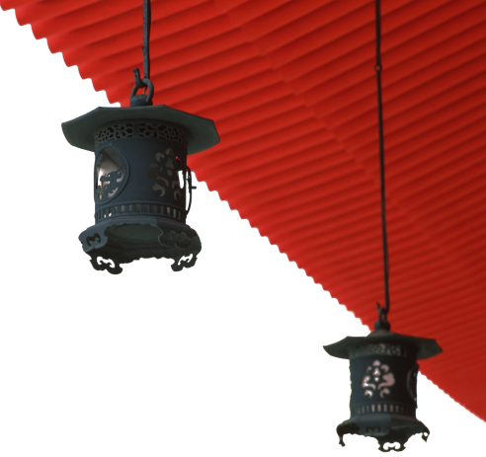



中国文化概况
A GLIMPSE OF CHINESE CULTURE

Slide 2
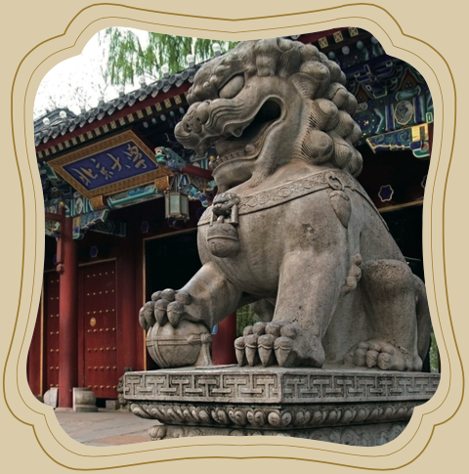
Chapter 4
Education

Slide 3
学习目标
了解中国教育发展简史;
掌握古今教育有关常用术语;
探讨中国教育现状及心目中的
优秀教师标准。

Slide 4

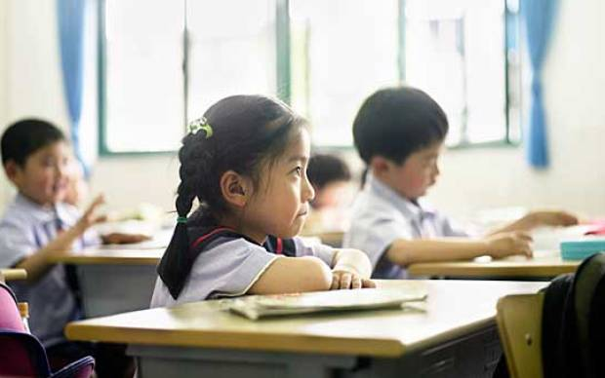
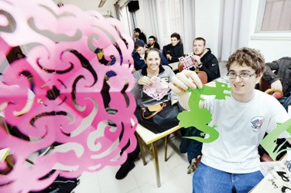
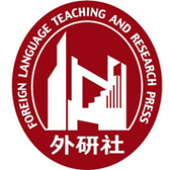
1
Overview
2
3
Lead-in Activity
Education
in China
Discussion &
Presentation

Slide 5
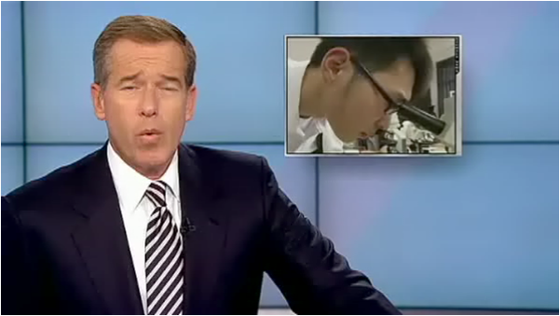
Lead-in Activity
Watch & Think
Watch the video clip and discuss the reason why Shanghai schools outperform the Entire World On Tests.

Slide 6

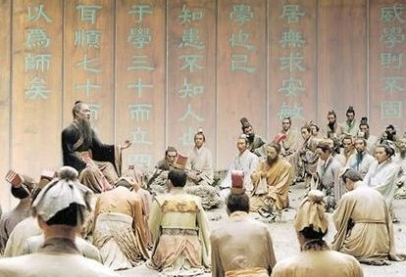
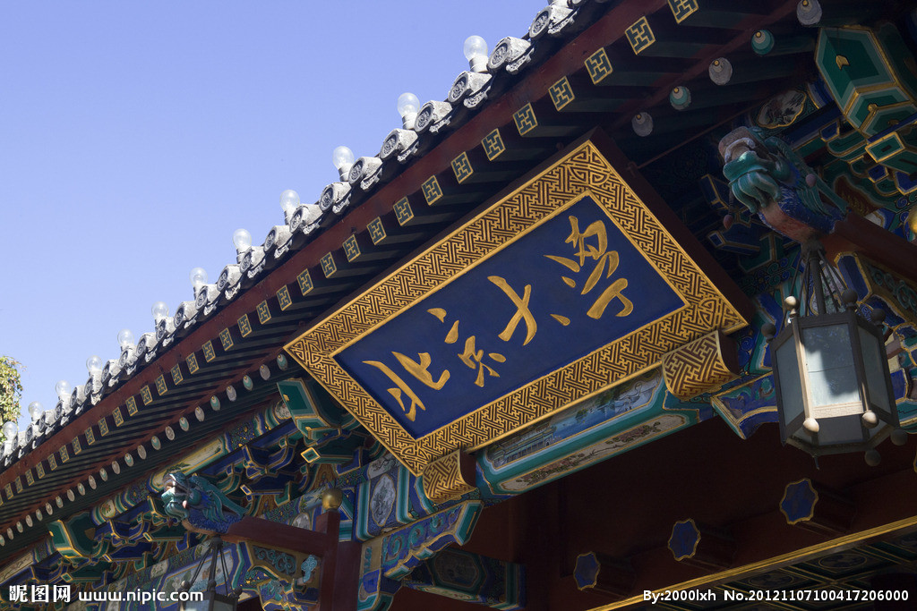
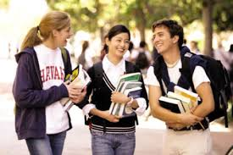
Education in China
1
2
3
Traditional
Education
Present
Education
International
Exchange &
Cooperation

Slide 7
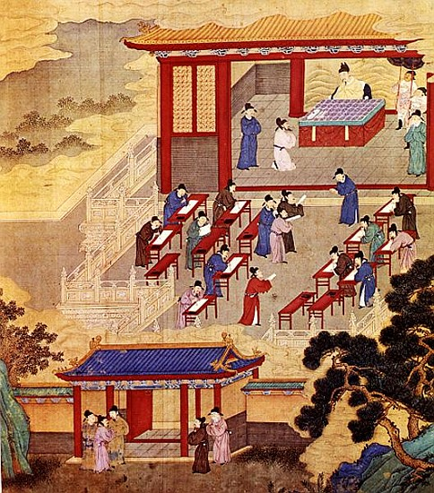
The Development of Traditional Education
Private Schools
Official Schools
Imperial Civil
Examination System

Slide 8
The Development of Traditional Education
Private Schools
A school set up by a family, clan, or teacher that
Generally with just one teacher giving individual tuition
No set textbooks nor specified time span of study
Prevailed In the Spring and Autumn Period
Many scholars of different schools of thought spread their teaching in this way.
The private school run by Confucius was the largest and most influential.

Slide 9
The Development of Traditional Education
Official Schools
Began during the Western Zhou Dynasty
Only children of nobles were admitted.
The official schooling system included a central school and local schools in different administrative regions.
Teaching materials: centered on the Four Books and the Five Classics (四书五经)
Gradually deteriorated after the Sui dynasty

Slide 10
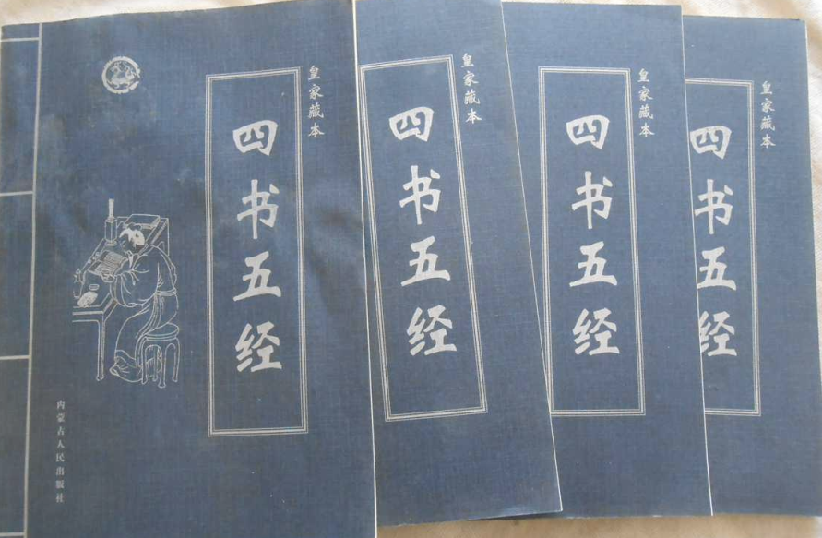
The Development of Traditional Education
Official Schools
Four Books
The Great Learning 《大学》
The Doctrine of Mean 《中庸》
The Analects of Confucius
《论语》
Mencius 《孟子》
Five Classics
The Book of Poems
《诗经》
The Book of History
《尚书》
The Book of Rites
《礼记》
The Book of Changes
《易经》
The Spring and Autumn Annals 《春秋》

Slide 11
The Development of Traditional Education
Official Schools
The Academy of Classic Learning
Came into being during the Tang Dynasty and continued until the end of the Qing Dynasty
Established in various localities for studies and lectures
Existed for thousands of years and were more like the present higher education institutions and libraries
Became the gathering places for scholars, celebrities, and intellectuals
When the imperial civil examination system was abolished, most of the academies were converted into schools.

Slide 12
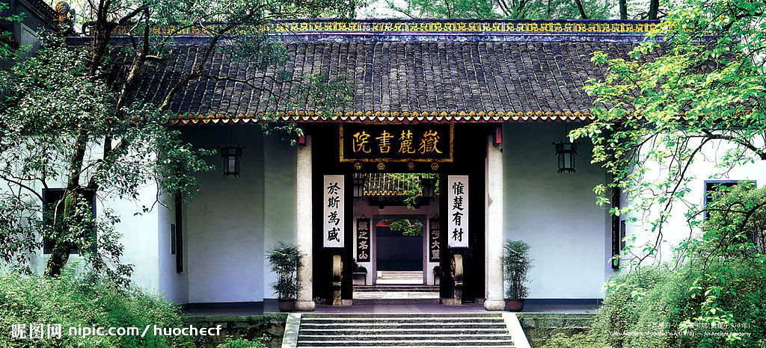
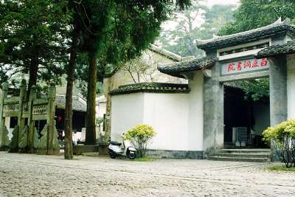
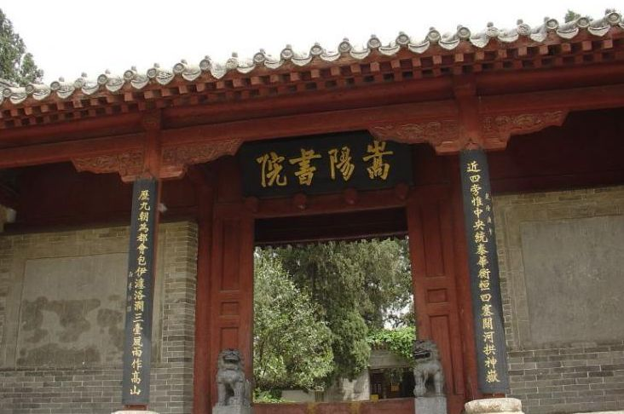
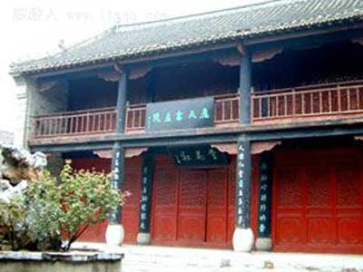
four famous academies of ancient China
The Development of Traditional Education
Bailudong Academy
(白鹿洞书院)
Yuelu Academy(岳麓书院)
Songyang Academy (嵩阳书院)
Yingtian Academy(应天书院)

Slide 13
The Development of Traditional Education
Imperial Civil Examination System
Dominated education in China’s feudal society
The method by which talented people were recognized and selected as government officials
Originated in the Sui Dynasty and lasted more than 1,300 years until the late Qing Dynasty.
Once served as a positive method to enable almost all men to realise their potential, regardless of their parentage or age.
Abolished in 1905

Slide 14
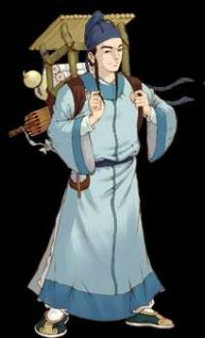
The Development of Traditional Education
Imperial Civil Examination System
held once every three years (during Ming and Qing dynasties)
Two Types
The civil examination featured writing, which
involved the writing of an Eight-part essay
(八股文), and was designed to select Jinshi.
The military examination featured martial
arts, including horsemanship, archery, and
weightlifting.
The candidate who won:
1st place: zhuangyuan（状元）
2nd place: bangyan（榜眼）
3rd place: tanhua（探花）

Slide 15
New Learning
The Development of Traditional Education
A very different type of school called New Learning, modeled after Western educational institutions, replaced the traditional official schools.
Public schools were founded in all parts of the country with many subjects of study offered as part of the curriculum.
After the Revolution of 1911, China introduced a Western educational system encompassing all levels from primary school to university.

Slide 16
Education in China
1
2
3
Traditional
Education
Present
Education
International
Exchange &
Cooperation

Slide 17
Present Education
Present Education System
Basic Education
Senior Middle School and Secondary Vocational School
Higher Education
Adult Education
Special Education
Vocational Education
Education for Ethnic Groups

Slide 18
Present Education
Basic Education
Encompasses:
preschool education
primary school education
middle school education (junior middle and senior middle)
Length: five or six years in primary schools
three years in junior middle schools
three years in senior middle schools.

Slide 19
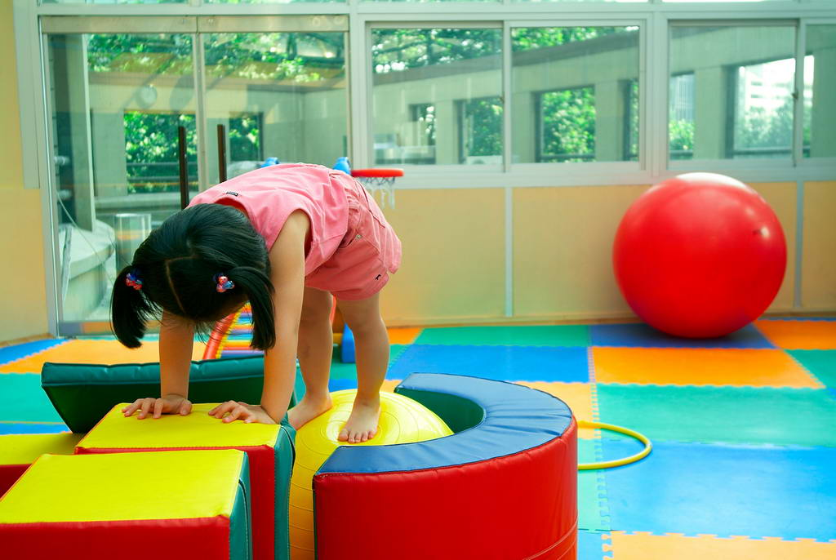
Present Education
Pre-school education
Two main forms:
Nurseries
provide care for babies under the age of three.
There are day nurseries as well as boarding nurseries (全托)
Kindergartens
enroll children from age three to six.
Game playing forms the main part of their educational activities
generally staffed with teachers, nurses and doctors
formulated regulations and rules to standardize the performance of kindergarten teachers and assessments.

Slide 20
Nine-year Compulsory Education
Present Education
Requires each child to have nine years of formal education
Composed of two parts: six-years in primary school
three-years in junior high school.
After junior middle school , student should choose between vocational school and a general education in senior middle school.
The government plays a dominant role
private social circles play a supplementary role
Project Hope (希望工程) and the Spring Bud Project (春蕾计划) have helped children, especially girls, in poor areas to attend schools.

Slide 21
Senior Middle School and Secondary Vocational School
Present Education
Senior Middle School
a preparation period for the students to enter colleges and
universities.
a choice between liberal arts and science at the end of the
first academic year
An examination taken to get the Certificate of Graduation
for Senior Middle School
The National College Entrance Examination is an academic
examination held annually in China aimed to select high-
school graduates for college admissions.

Slide 22
Senior Middle School and Secondary Vocational School
Present Education
The National College Entrance Examination
An academic examination held annually in China aimed to select high-school graduates for college admissions.
Arranged at the end of the spring semester
Senior middle school graduates across the country take the examination simultaneously.
exam courses include: Chinese, mathematics, English, physics, chemistry, history, geography, biology, and politics.

Slide 23
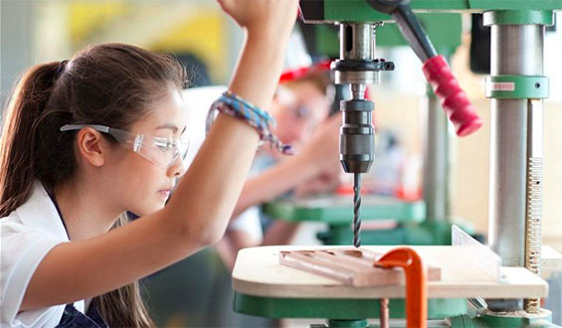
Senior Middle School and Secondary Vocational School
Present Education
Secondary vocational education
An alternative to high school.
Prepare students for the lines of production, services, technical services, management, etc.
After three years of study, students can go directly into jobs in the relevant fields.

Slide 24
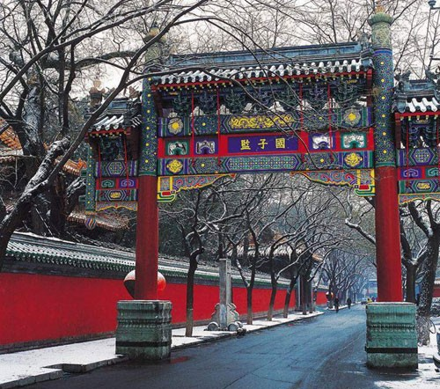
Higher Education
Present Education
History
can be traced back to the Han Dynasty about 2000 years ago.
the institute for higher education
Han: taixue (太学)
Since the Sui: guozijian
(国子监)

Slide 25
Higher Education
Present Education
Higher education today’s China
More than 2,000 universities, colleges, and institutes
four- or five-year programmes
bachelor’s degree, master’s degree doctor’s degree
Departments or schools are the basic teaching units.
basic courses, basic specialised courses, and specialised courses, as well as extracurricular (课外)activities
adopts the policies of opening wider to the outside world.
Project 211(1997) and Project 985 (1998)
student-loans, scholarships, subsidies (助学金), and remission of tuition fees.

Slide 26
Adult Education
Present Education
Two types:
certificate study:
• undergraduate studies, professional training, secondary
specialised education and secondary school education.
• Methods of delivery include correspondence, vocational
colleges, self-teaching programmes, etc.
non-certificate study
• literacy programmes, rural training for practical skills,
on-the-job training, and other continuing education.
• has the greatest number of potential students
• the first to use the distance education system
• makes lifelong learning possible

Slide 27
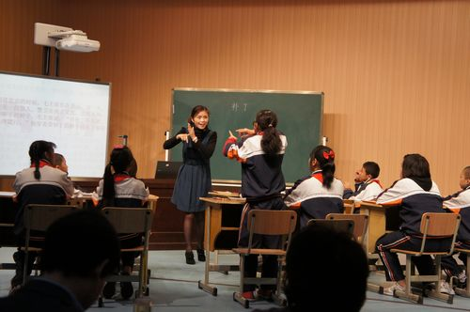
Special Education
Present Education
Using special methods, equipment, and resources to provide education for people with disabilities.
To make up for their physiological and mental deficiencies by enabling them to acquire labor skills of varying degrees, gain essential living skills, and to develop the ability to adapt to society and communicate with others.
The Chinese government has always attached great importance to special education. (laws, policies and founds)
Special education has developed rapidly in China.

Slide 28
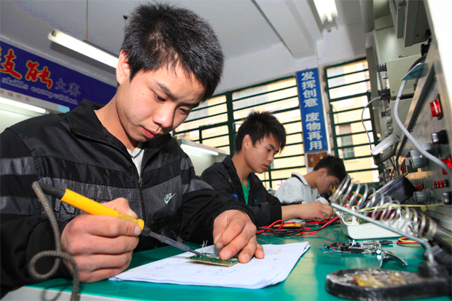
Vocational Education
Present Education
Mainly carried out by advanced vocational schools, secondary technical schools, skilled workers’ schools, vocational middle schools, job training centers, and other technical training schools.
Run by community groups or individuals
Highly valued for its employment-enhancing effect.

Slide 29
Present Education
Education for Ethnic Minority Groups
An important component of China's educational strategy
Clauses to help its develop have been clearly stipulated In the Constitution.
Administrative organs have been set up for implementing the country’s policies concerning this issue.
The government has been studying and solving the unique problems related to it.
Government funds have been allocated ( 划拨 ) to meet its expenditure needs.
A large number of ethnic people have been trained with special skills and have made a great contribution to the development of ethnic regions and China.

Slide 30

International Exchanges and Cooperation
Studying abroad
The reform and opening- up policy encourages international communication and cooperation in education
Now going abroad to study is more and more popular among younger students.
Both the quantity and scale are unprecedented in the history of China.
Students who have studied abroad are an important intellectual resource for China.

Slide 31
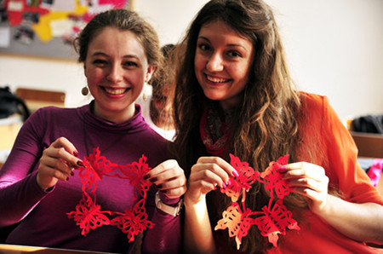
International Exchanges and Cooperation
International Students in China
The first group of 33 international students arrived in 1950.
By the end of 2005, the total number of international students, who are from more than 160 different countries and study in 568 universities or colleges in China had increased to 870,000.
In the past, foreign students mainly received continuing education.
Now, many foreign students are studying for bachelor’s, master’s, or doctoral degrees.

Slide 32
International Exchanges and Cooperation
Other Exchanges and Programmes
Academic exchanges
Have developed rapidly since the reform and opening-up.
engage in exchanges of scientific research with their foreign counterparts.
sound progress in bilateral and multilateral educational cooperation have been made.
Confucius Institute
non-profit public institutions
help to promote and disseminate Chinese culture and Chinese language education, and to deepen the friendship between China and the rest of the world.

Slide 33
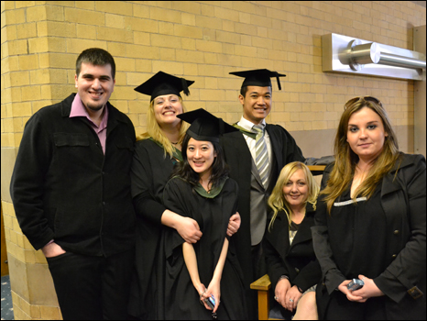
Discussion
Nowadays studying abroad has become a trend among Chinese students, even primary school students.
Please think of the reasons why this trend is so popular in China. Share your opinions with the class.

Slide 34
Students’ Presentation
Cramming method ( 填鸭式教育) has long been known to be widely practised in schools in China. In recent years, China has endeavored to improve the quality of its education at all levels and develop students’ critical thinking. You are going to introduce the changes in China’s education to a group of international students.
The introduction will involve the following points:
1. the phenomenon of the cramming method in schools in China;
2. the results of non-critical thinking (compared with the
education in other countries);
3. the reasons why critical thinking in education is important;
4. the policies China has taken to change the current
situation.

Slide 35
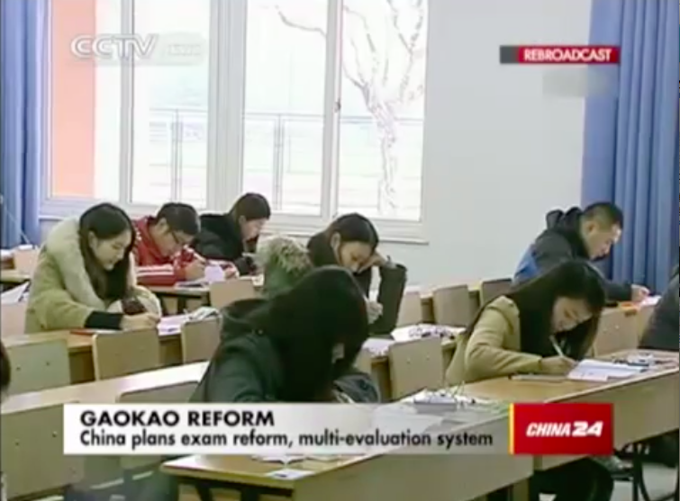
Students’ Presentation
A little inspiration for you
Watch the video below. Pay special attention to the information it gives.

